Slide 1

PowerApps Hackathon

Slide 2

Agenda
PowerApps 101
Scenario brief and design
(Power)Hacking!
Present your solution – there will be prizes!

Slide 3

Your Hackathon buddies
Vanessa Larsen – Intergen
Richard Burdes – Datacom
Paul O’Flaherty – Datacom
Donald Harman – Ngāi Tahu
Sudeep Ghatak – Intergen

Slide 4

Today’s Goals
Create a Canvas App
Connect to data sources
Filter data
Work with multiple screens and navigation
Customise the user experience
Become a PowerApps superhero!

Slide 5
Common Data Service for Apps
PowerApps
Power BI
Microsoft Flow
Dynamics 365
Microsoft Power platform
Azure
Office 365
Standalone Apps
Data Connectors

Slide 6


Powerful mobile app development tools
Azure
Use custom connector
Build custom connector
Custom connector (e.g. Web API, Azure Function)
Power User / Citizen Developer
Professional Developer
PowerApps
Visual Studio / Visual Studio for Mac
+Xamarin
Common Data Service for Apps
CDS SDK

Slide 7


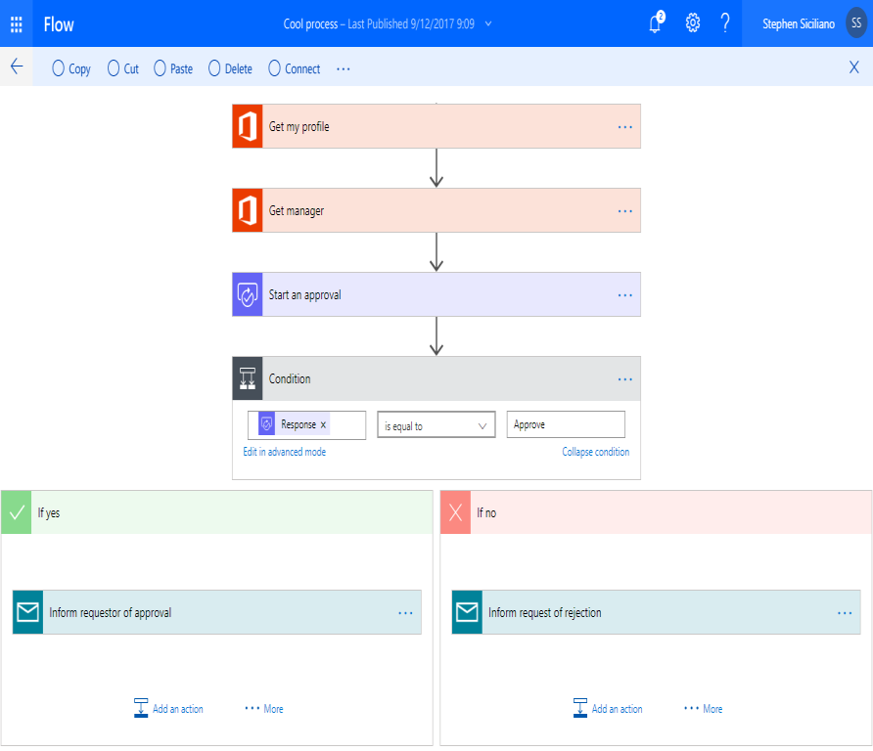
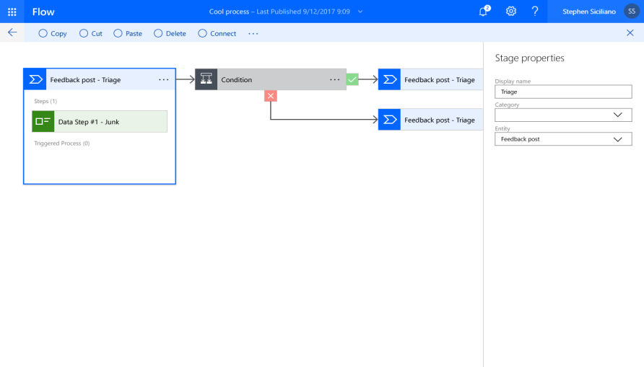

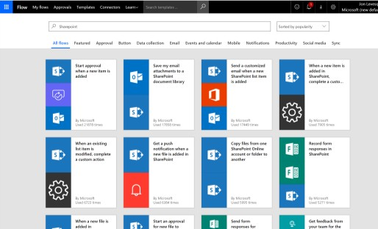
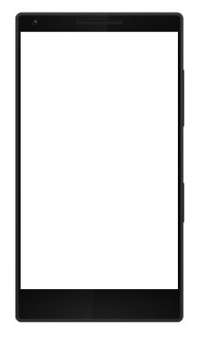
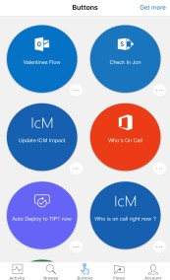
Automate your Processes with Microsoft Flow
Automate and model business processes across your apps and services
From simple automation to advanced Flows with branches, loops, and more
Trigger actions, grant approvals, and get notifications

Slide 8

Practical (or just fun) Ideas
https://youtu.be/0-ZWqs_emQA?t=714
https://www.youtube.com/channel/UCGfWR2ekfRFckLjev6eQYLg - existing business scenarios from Microsoft
https://www.youtube.com/watch?v=kwJrTpn_kSo&list=PL8IYfXypsj2DU3EwoaeBYiuuQTvcscJfo Guided Learning https://www.youtube.com/channel/UCnUwvZBeu4P_desNZthZWiA - Paul O'Flaherty
https://www.youtube.com/watch?v=Jbrw81bN4oc&list=PLembhGBTBT0jHovVQaj2Nn9KdyNzz97NW - Rich Burdes

Slide 9
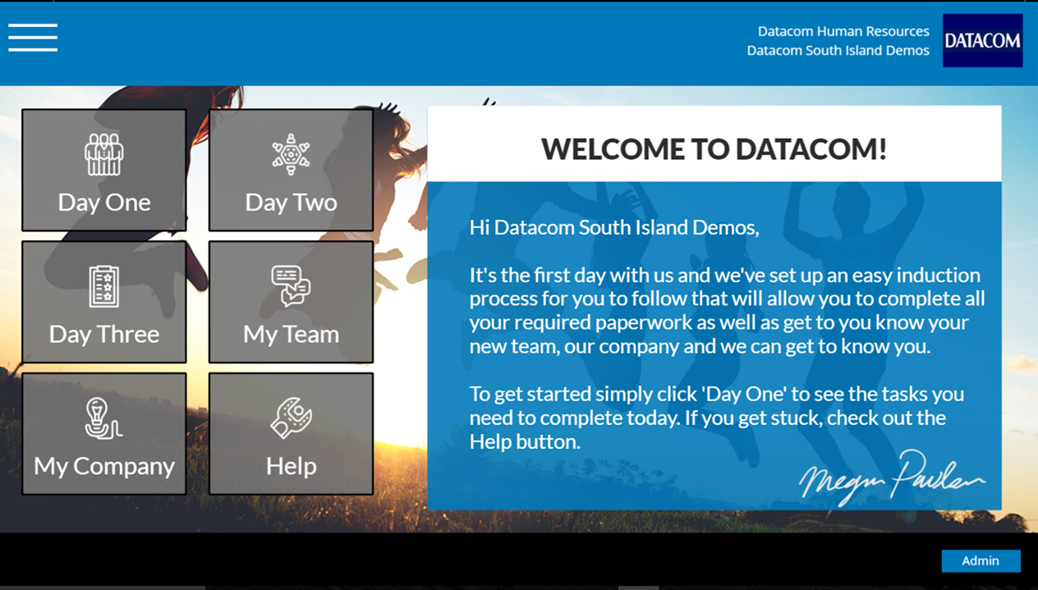
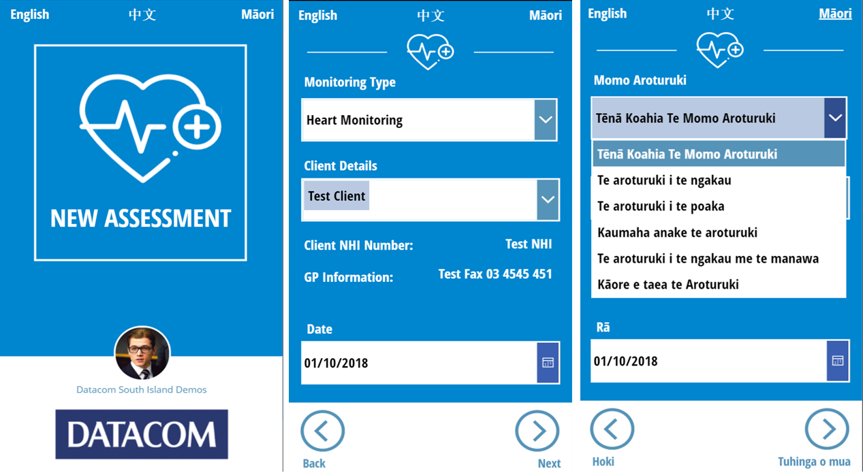
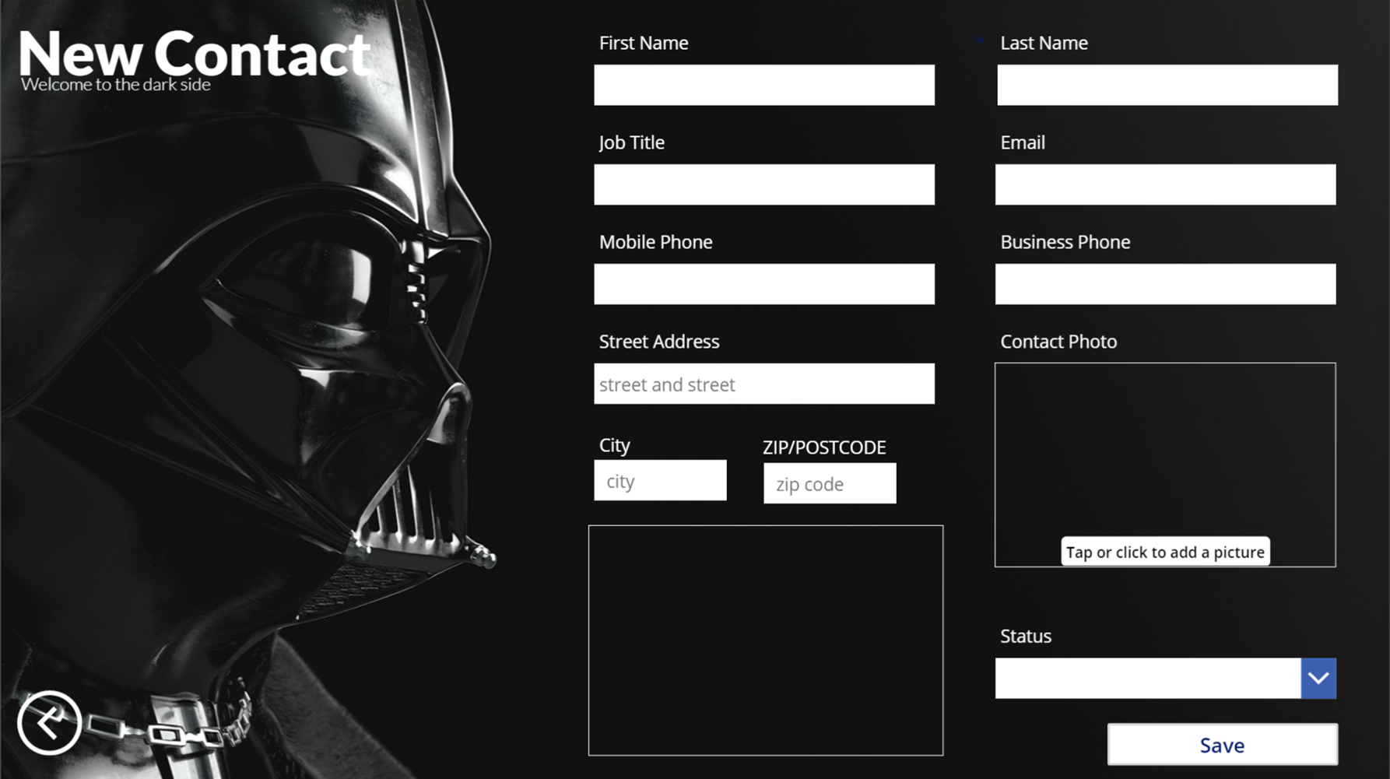
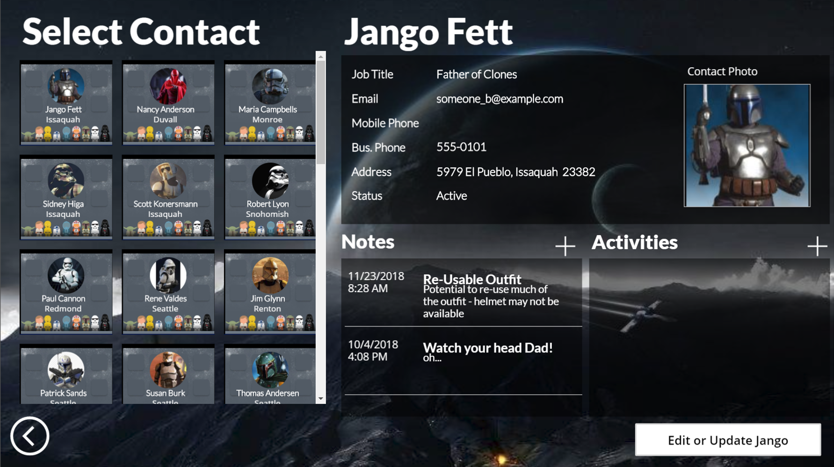

Technical Section
Before we begin..
Some inspiration!

Slide 10
Technical Section
Your Environment – O365 E3 with Plan 2 for PowerApps and Flow
O365 will give you all you need for Canvas Apps.
Plan 2 will allow CDS (Common Data Service) as a connection that can act as your own database / can sync directly with Dynamics 365
PowerApps is the child of Excel and PowerPoint - you can be basic or go wild.

Slide 11
Quick Tips
Think about using SharePoint as your Datasource
Think about using the auto create 3 screen app – then adjust
Build out your Datasources BEFORE you build our your apps!
Ask for Help!!!

Slide 12
Technical Section
PowerApps Formulas to be familiar with for today. OnStart / OnVisible - things you want to have happen on initial load, then per screen
Form – to gather data in an app
Gallery - to present rows of data on screens
SubmitForm or Patch - to send your form data to a data source
Set – for working with variables
Navigate - to move between screens
ResetForm - to clear a previous entry
Search or Filter – to look up people
Connections - plug and play connect to your CDS / SharePoint / SQL data sources
https://docs.microsoft.com/en-us/powerapps/maker/canvas-apps/formula-reference

Slide 13
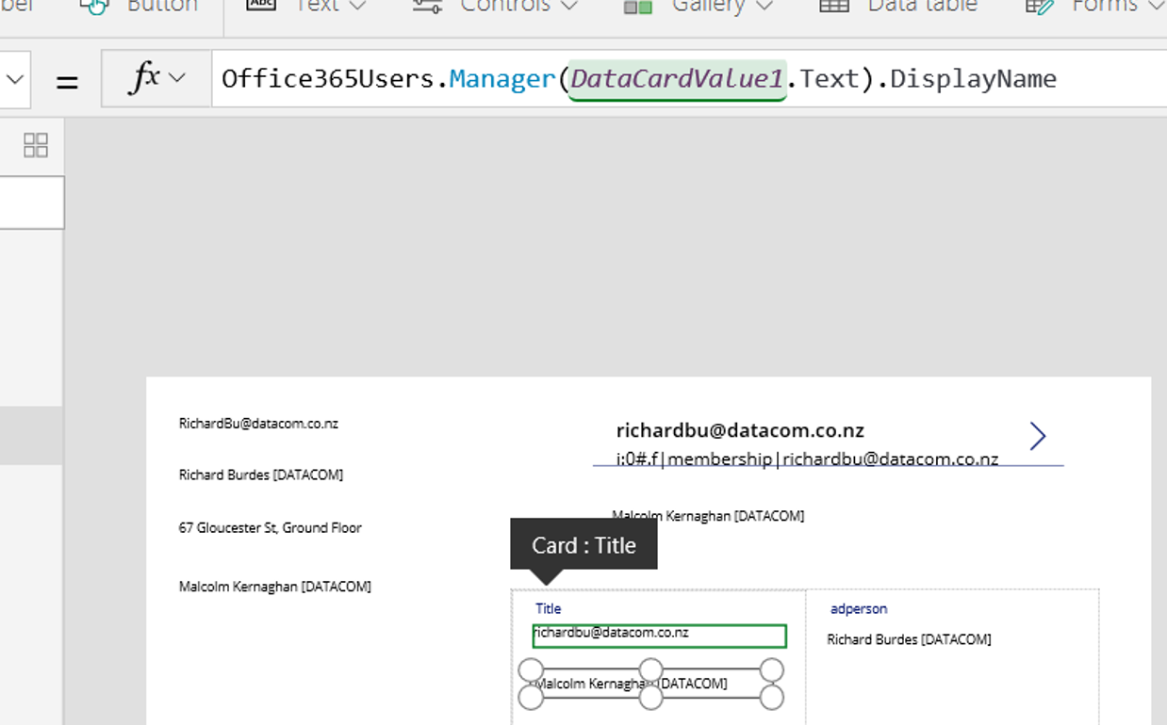
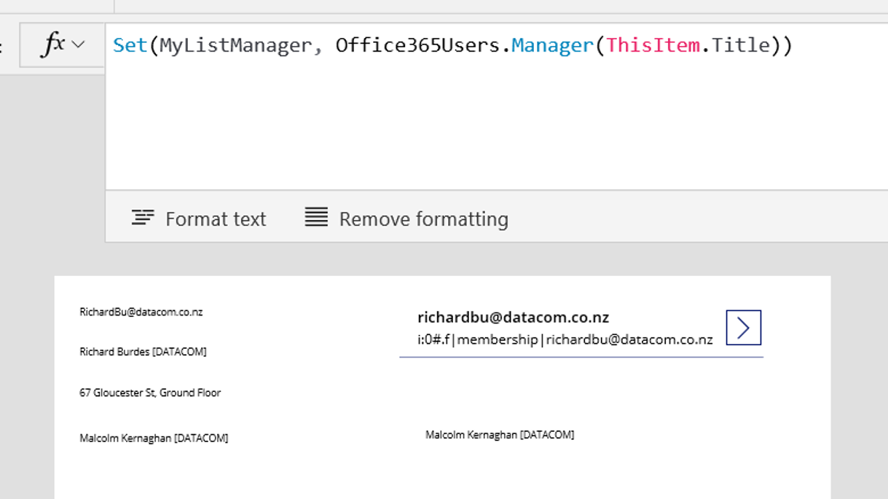
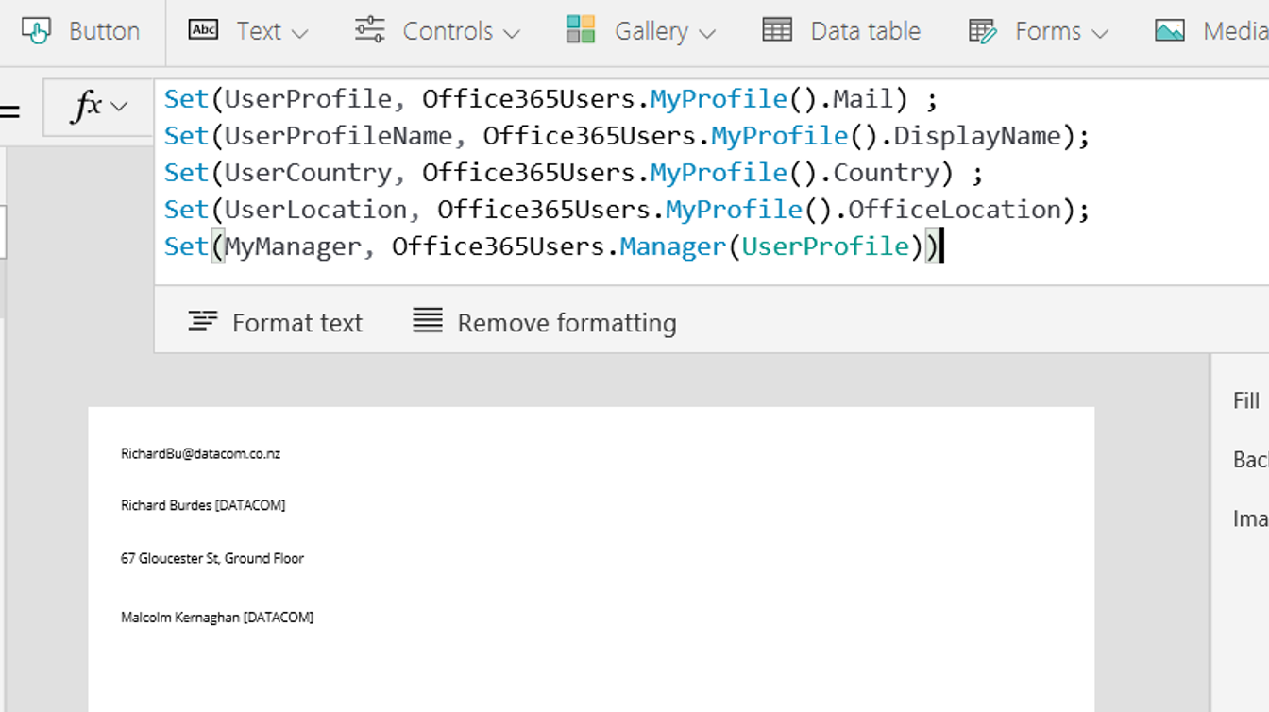
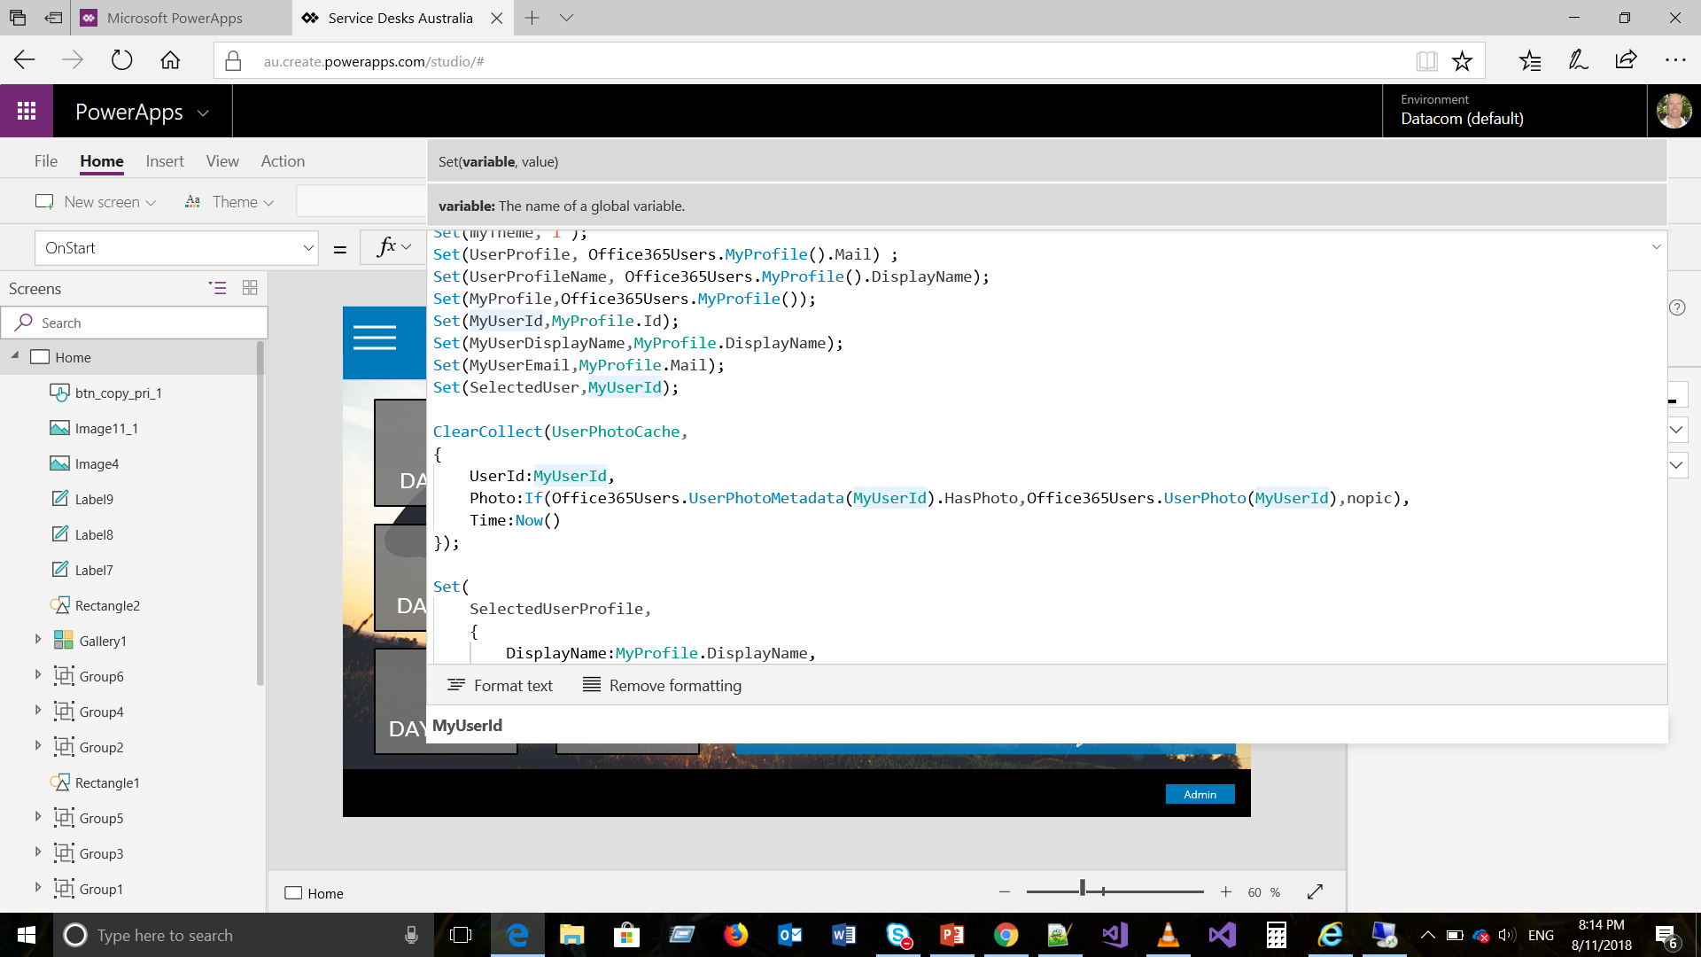
Technical Section - Formulas
Some examples of common formula syntax

Slide 14
Tech section
Canvas Apps
CDS
Model-driven apps
Flow
High level – enough to get started
5 mins

Slide 15

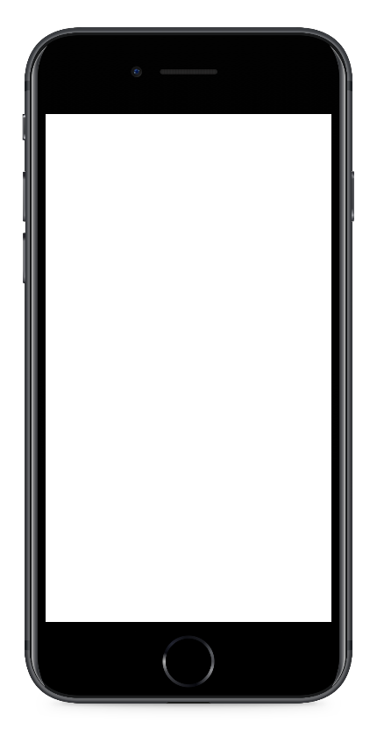


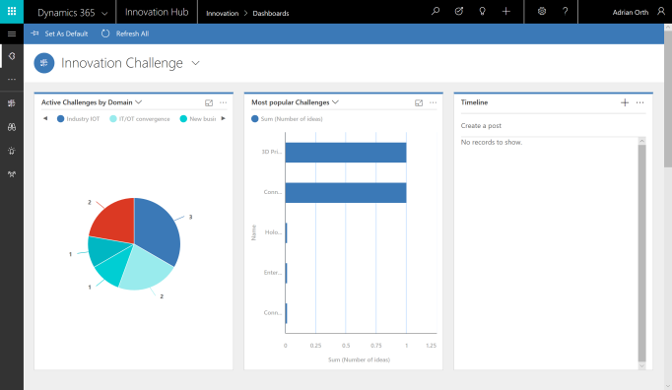
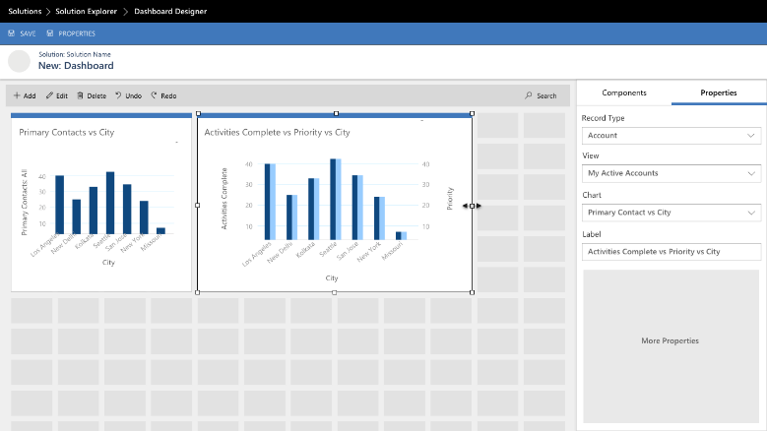


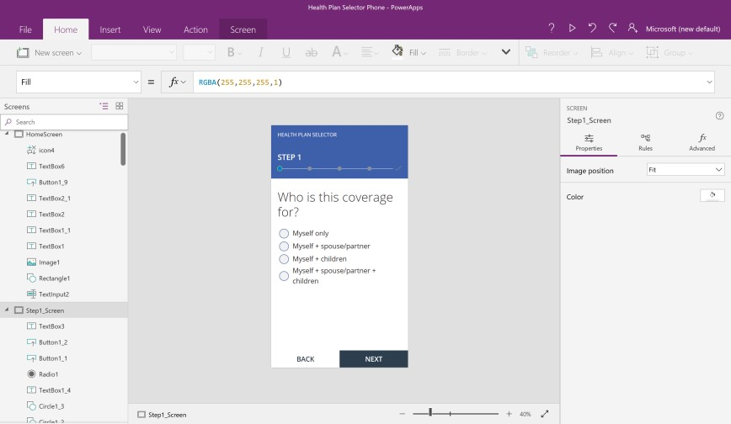
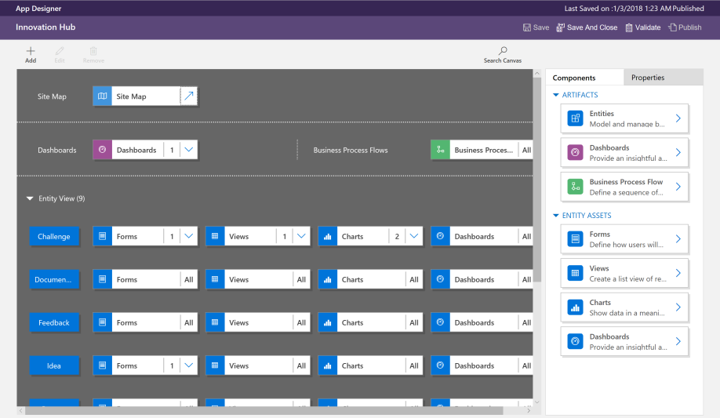
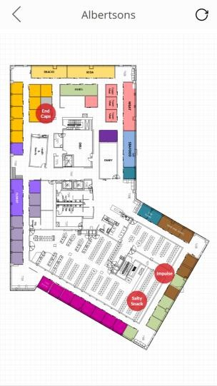



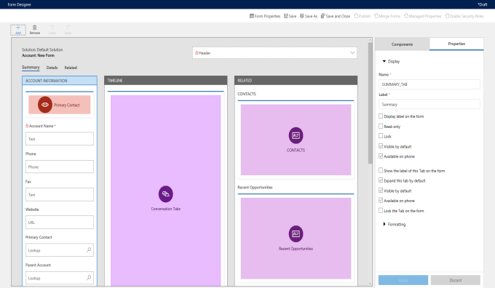


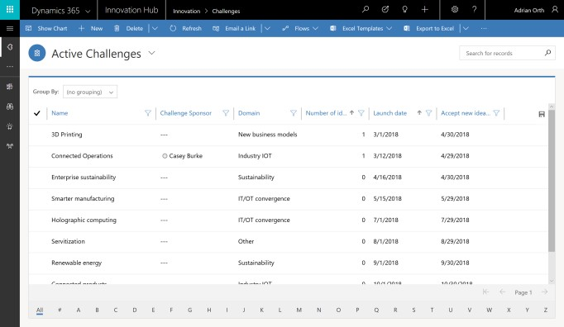
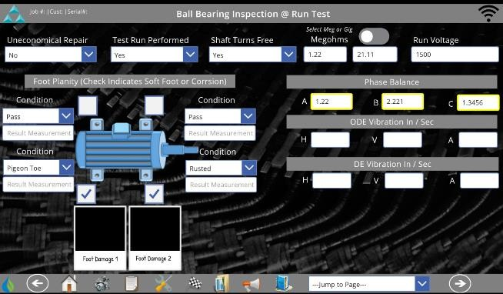
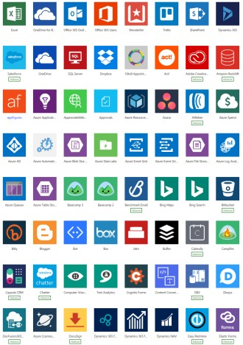
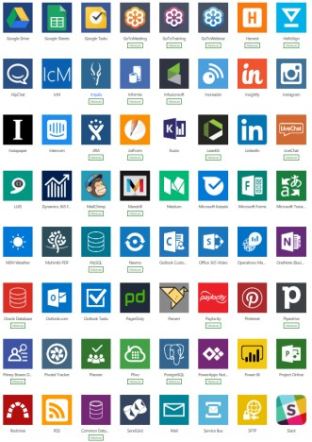

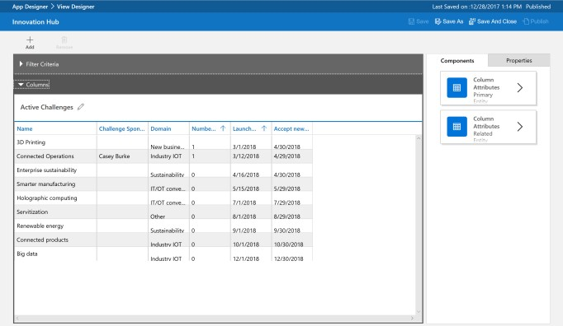
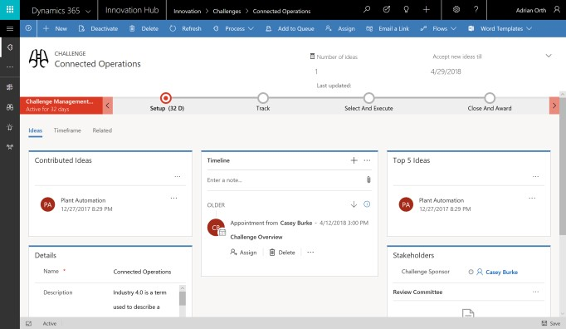
Focus on Canvas Apps
Canvas apps
Start with user experience
WYSIWYG designer
Task- and role-based apps
Mash up data from 200+ sources
Model-driven apps
Built on the Common Data Service for Apps
Start with a data model, relationships, and
business processes
Build End-to-End business applications

Slide 16

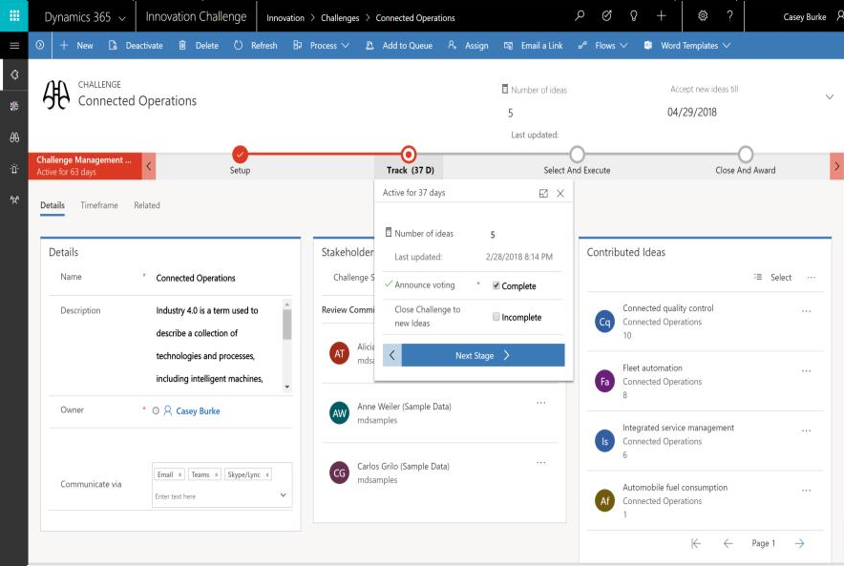
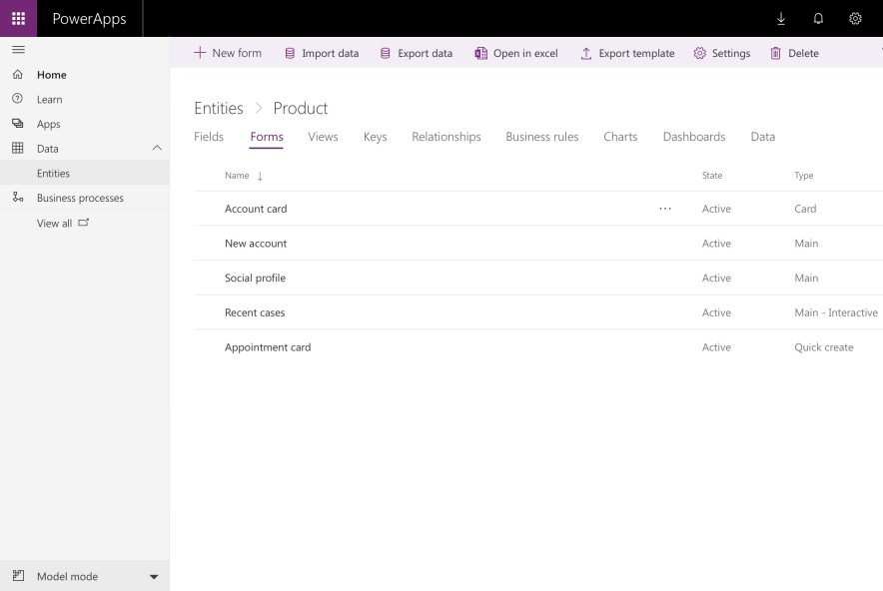
Jumpstart apps using a standardized data model with
business logic, security and integration built-in
Extend to your own needs and integrate across your apps and services
Seamless Dynamics 365, Office 365, and Azure integration, augmented with data from industry partners

Slide 17
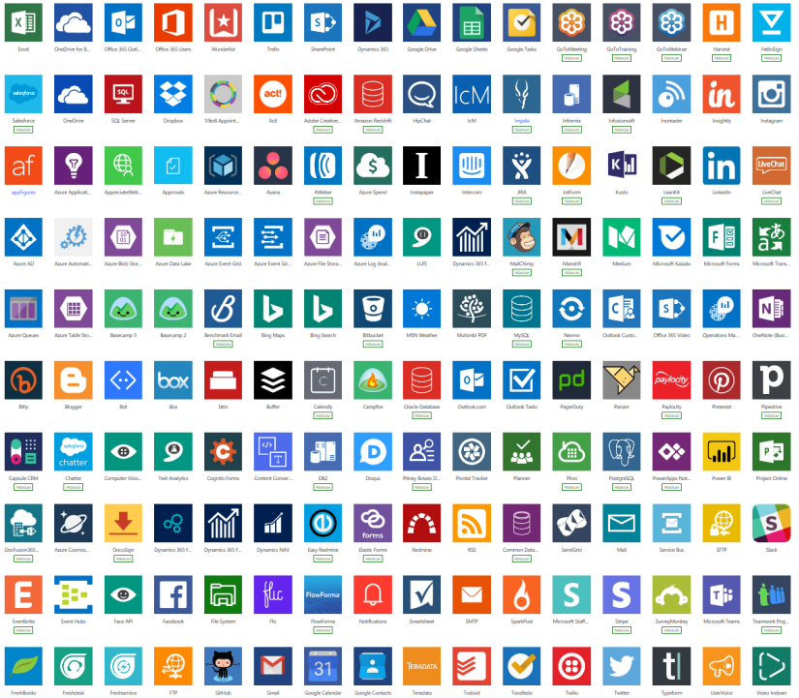
Cloud and on-premises connectivity
Built-in connectivity to 200+ cloud services, files, databases, web APIs, etc.
Seamless hybrid connectivity to on-premises systems via the On-Premises Data Gateway
Build custom connectors for everyone to leverage

Slide 18

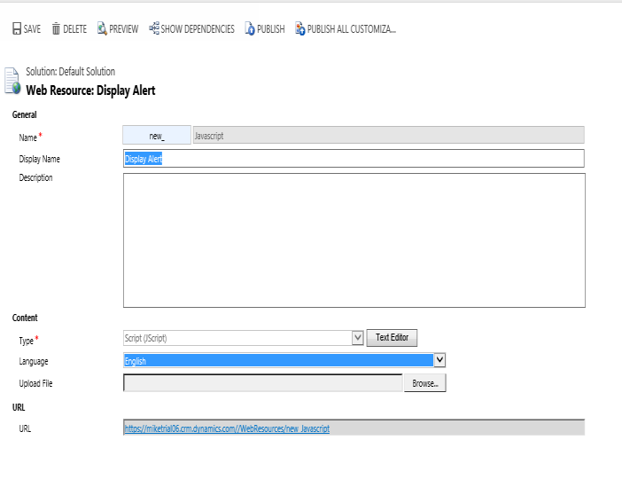
Want custom? Go for it!
Extend applications using custom code
Build custom connectors that everyone can use
Write advanced client or server-side logic leveraging Azure Machine Learning, Cognitive Services, Bing APIs, custom code or any service of your choice

Slide 19
Scenario/Brief
Imagine you work for an organisation that needs a more streamlined way to track visitors to the main office.
This is what their current visitor sign-in sheet looks like….

Slide 20
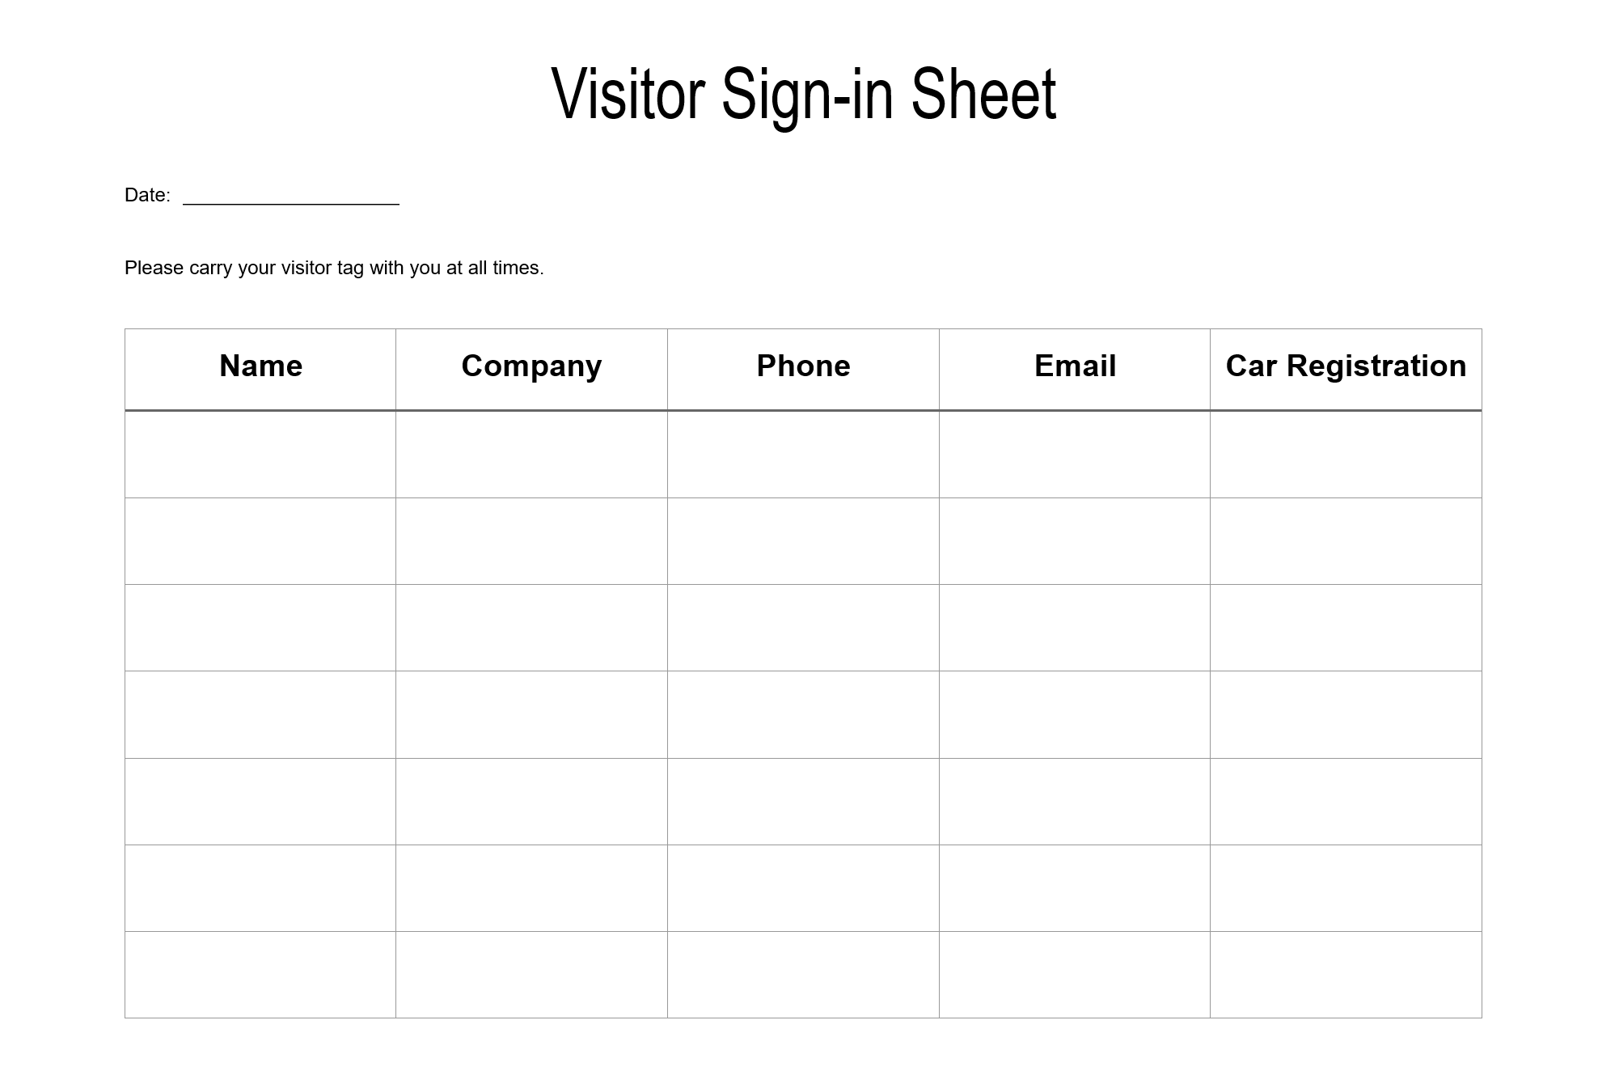

Slide 21

Some challenges to solve…
The new Health and Safety policy mandates that all personnel are signed in and out of the building in case of emergency.
Karen, the receptionist, works part-time so sometimes the front desk is unoccupied. Staff still need to be notified when they have a visitor. They usually carry their smartphone with them and use a lot of email.
The business will fund a tablet that can be used for visitors to sign in at the reception desk.

Slide 22

Step 1: Team Up & Design
Get into groups of 3 to 4
Get your login cards
Design your user flow
Wireframe your solution
How will your solution solve the business problem?

Slide 23
Step 2: (Power)Hacking!
Set up your environment
Create a Canvas App
Automate your process with Flow (optional)

Slide 24
Further Learning
Microsoft Learning - PowerApps
Microsoft Learning - Flow
edX PowerApps Courses

Slide 25
Present your solution
Submit your app by sending a link to:
<Link>

Slide 26
Give your Loudest Applause to:
Innovative use of Power Apps and/or Flow
Creatively solved the business problem
Met the constraints of the challenge
Flair and wow factor!

